Slide 1

Sports Event Management System
MFPE POD - 2

Slide 2
Prepared By:
S.No. | Name | Emp-Id
1 | Vaibhav Sharma | 2135218
2 | Ria Sao | 2134257
3 | Pratyusa Dwibedy | 2134589
4 | Arun Prakash | 2134609
5 | Vasanth B | 2134358
UNDER THE GUIDANCE OF OUR MENTOR R,ARUL AND OUR TRAINER WASEEM AKRAM

Slide 3
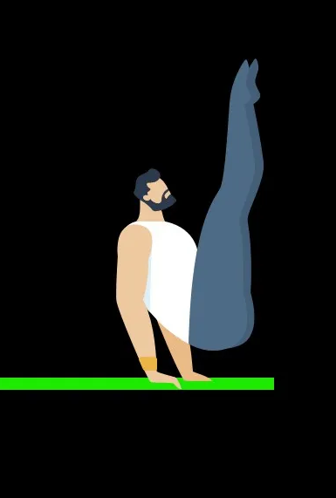
INTRODUCTION
This project aims to increase the organization’s ability to respond to the evolving sportplace through enhanced speed and flexibility.
The users will take less amount of time as compared to manual paperwork.
As a part of this project, we will be developing a service portal that consumes the microservices and responses back to the users who are participating an event according to the sports.

Slide 4
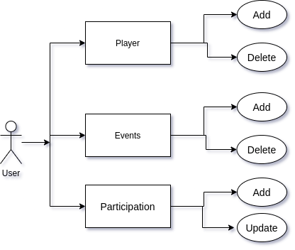
USE CASE DIAGRAM

Slide 5
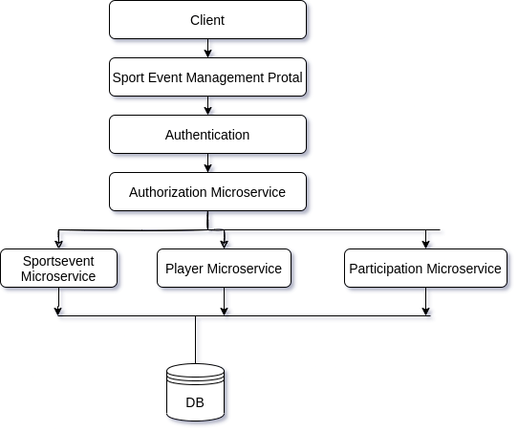
DATA FLOW DIAGRAM

Slide 6






TECHNOLOGY USED

Slide 7
Authentication Microservice And Api Gateway

Slide 8
Authentication Microservice
This is the security module of the application which authenticates the identify of the user.
This module requires username and password from the user.
The authentication microservice generates JWT token to give authorization to the users based on the claims made by the user.
API Gateway
API Gateways creates RESTful APIs that are HTTP based and enables client-server communication.
They implement standard HTTP methods such as GET, PUT, POST, PATCH AND DELETE.

Slide 9
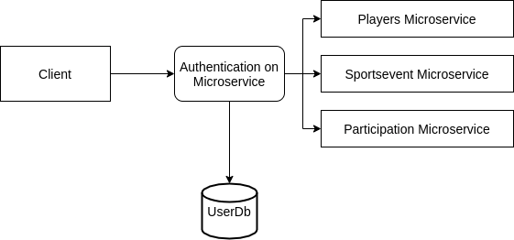
Data Flow Diagram

Slide 10
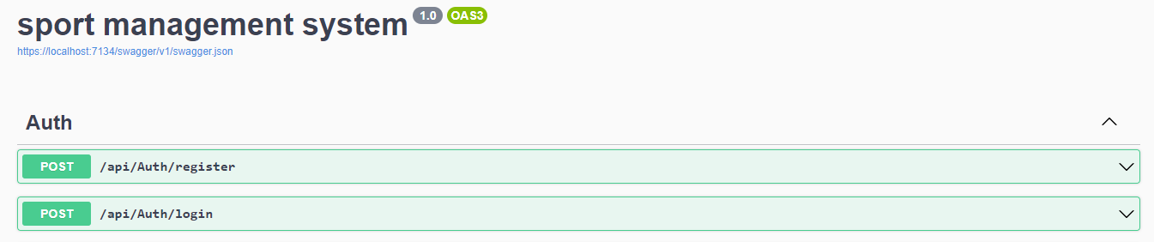
Swagger Implementation

Slide 11
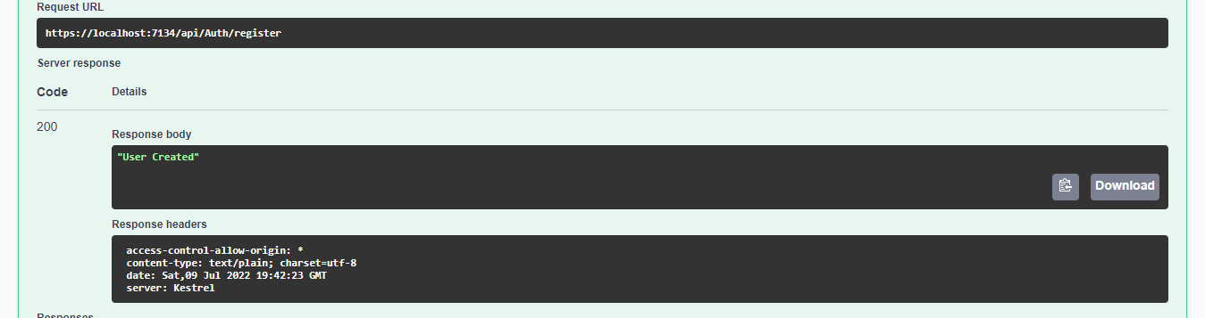
POST:/api/Auth/register

Slide 12
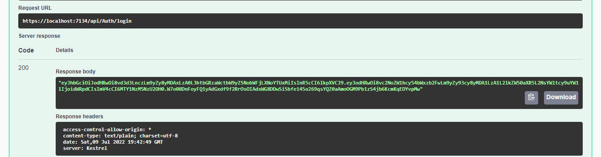
POST:/api/Auth/login

Slide 13
Sports Event Microservice

Slide 14
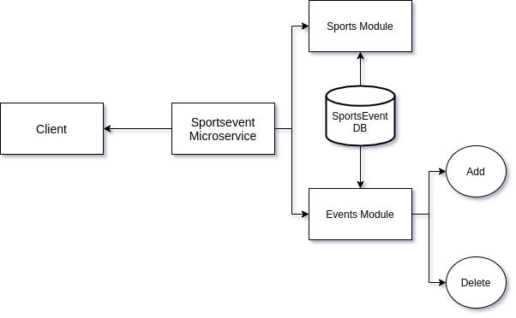
Flow Diagram

Slide 15
Entities
Sports
sportsId(PK) | int
sportsName | nvarchar
noOfPlayers | int
sportsType | nvarchar

Slide 16
Event
EventId(PK) | int
eventName | nvarchar
noofslot | int
eventDate | datetime
sportsName | nvarchar

Slide 17
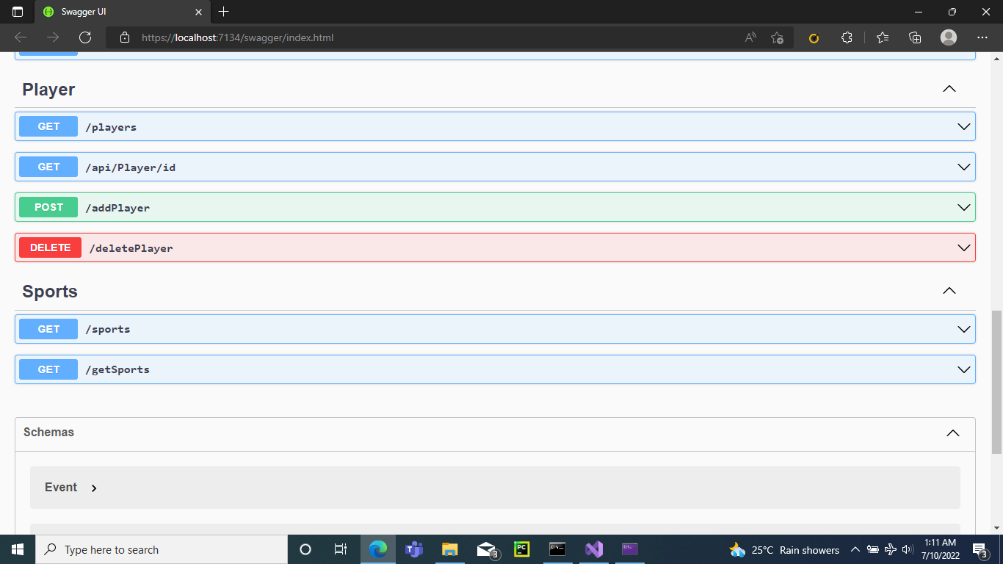
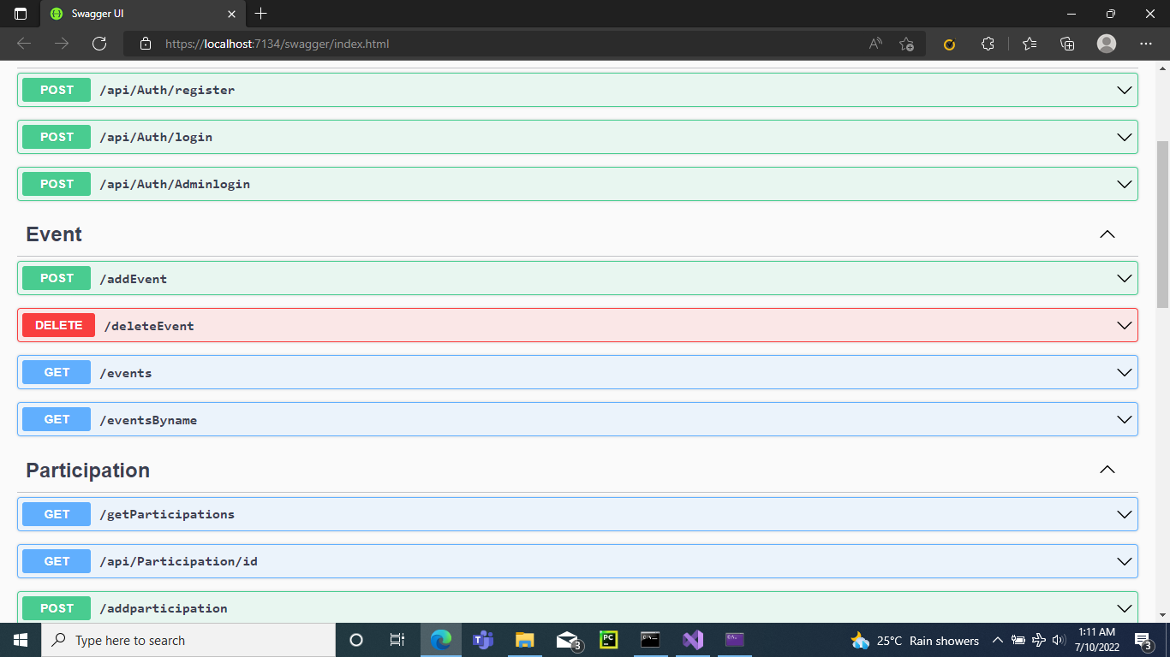
Swagger Implementation

Slide 18
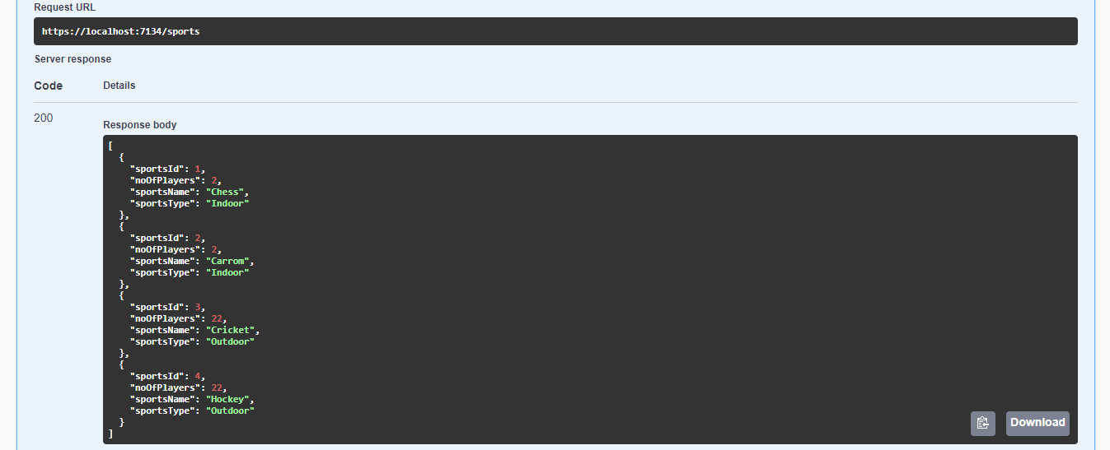
GET:/sports

Slide 19
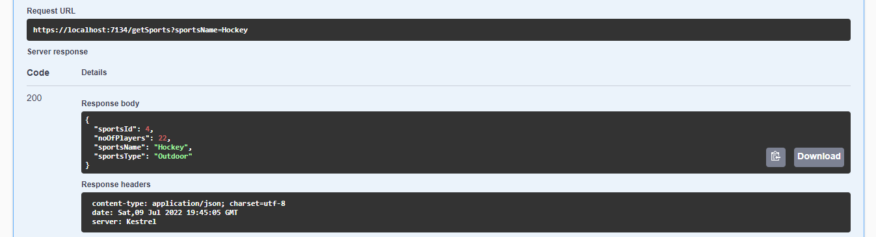
GET:/getSportsByName

Slide 20
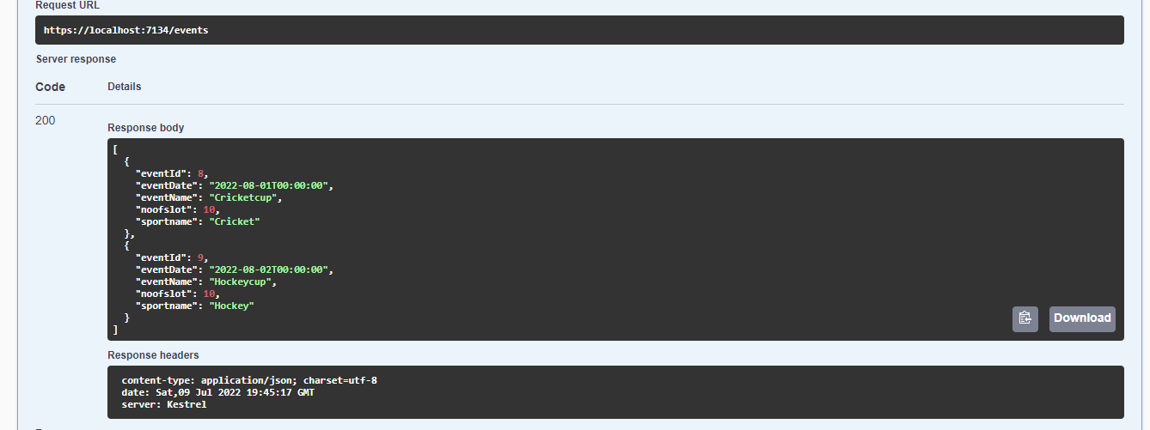
GET:/events

Slide 21
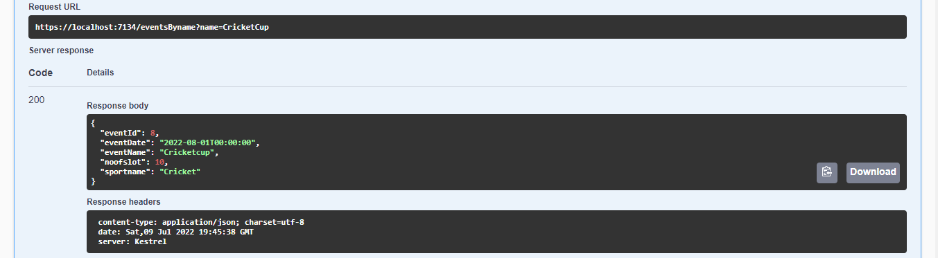
GET:/eventsByname

Slide 22
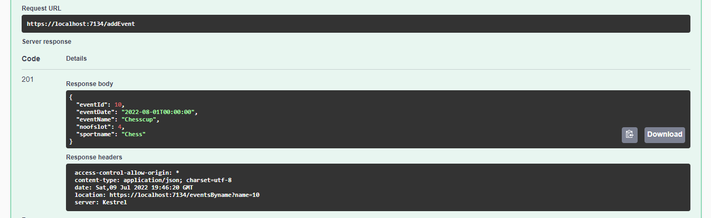
POST:/addEvent

Slide 23
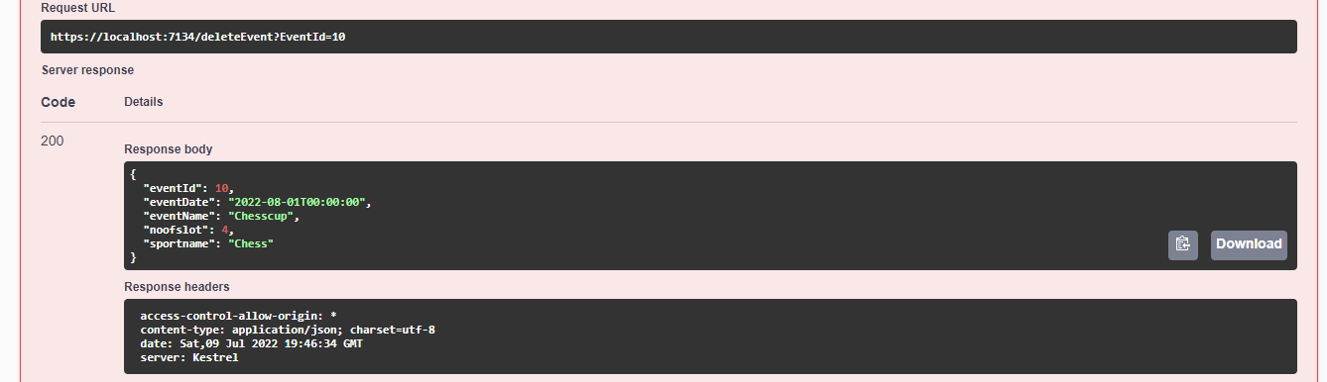
Delete:/deleteEvent

Slide 24
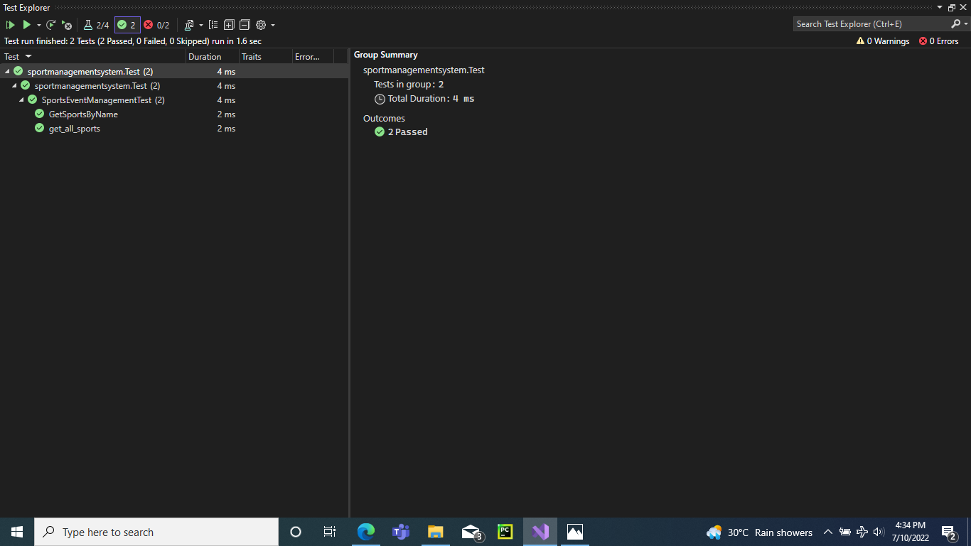
Sports Testing Implementation

Slide 25
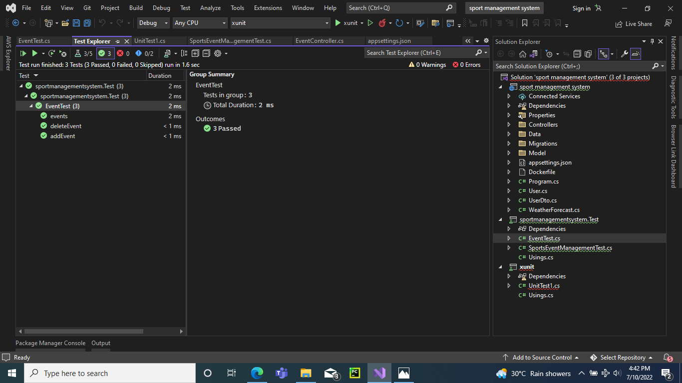
Event Testing Implementation

Slide 26
Player Microservice

Slide 27
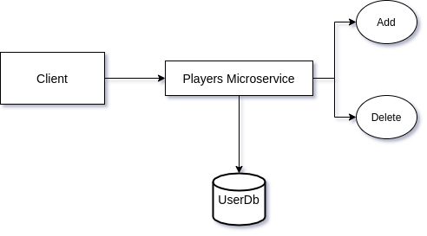
Data Flow Diagram

Slide 28
Entities
Player
PlayerId(PK) | int
playerName | nvarchar
age | int
contactNumber | bigint
email | nvarchar
gender | nvarchar
sportsName | nvarchar

Slide 29
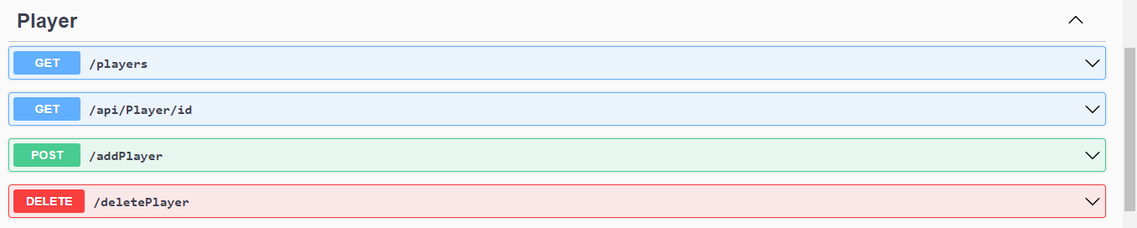
Swagger Documentation

Slide 30
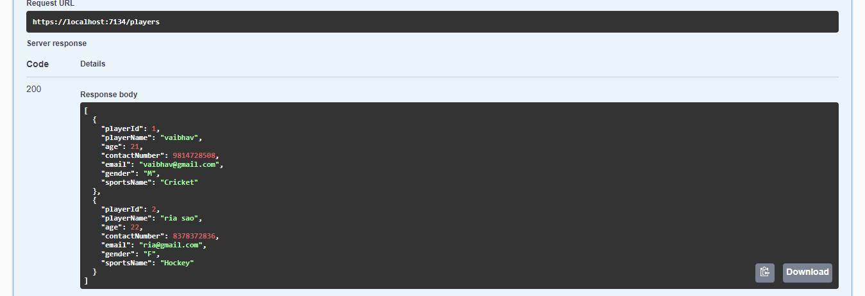
GET:/players

Slide 31
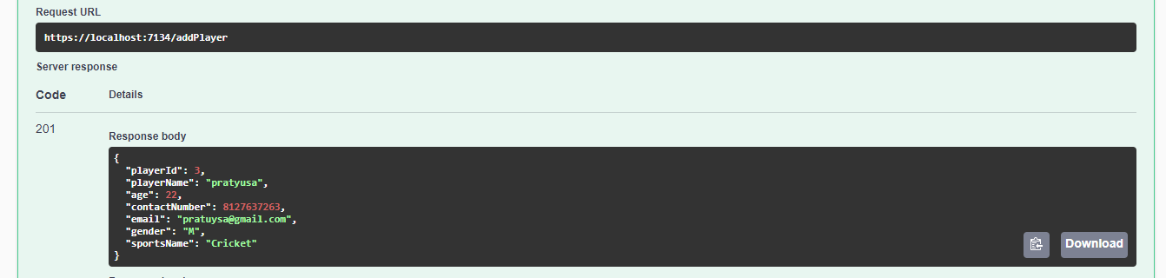
POST:/addPlayer

Slide 32
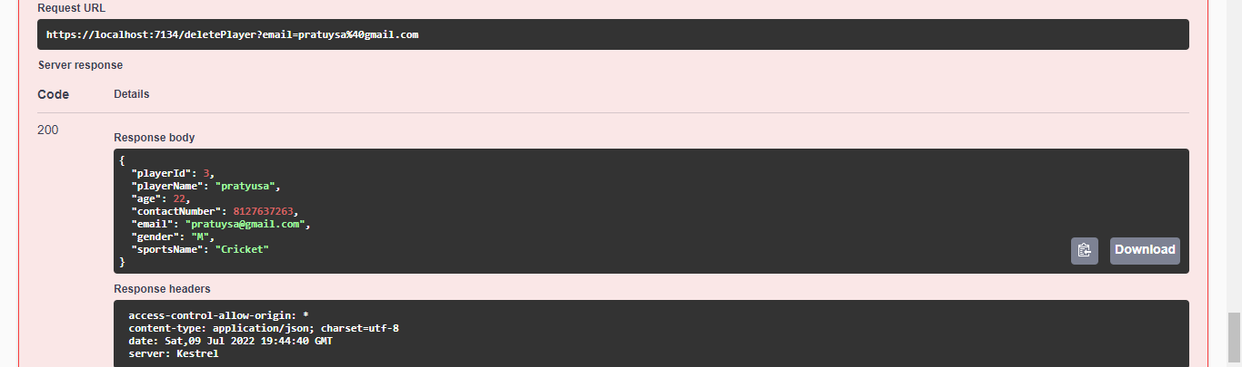
DELETE:/deletePlayer

Slide 33
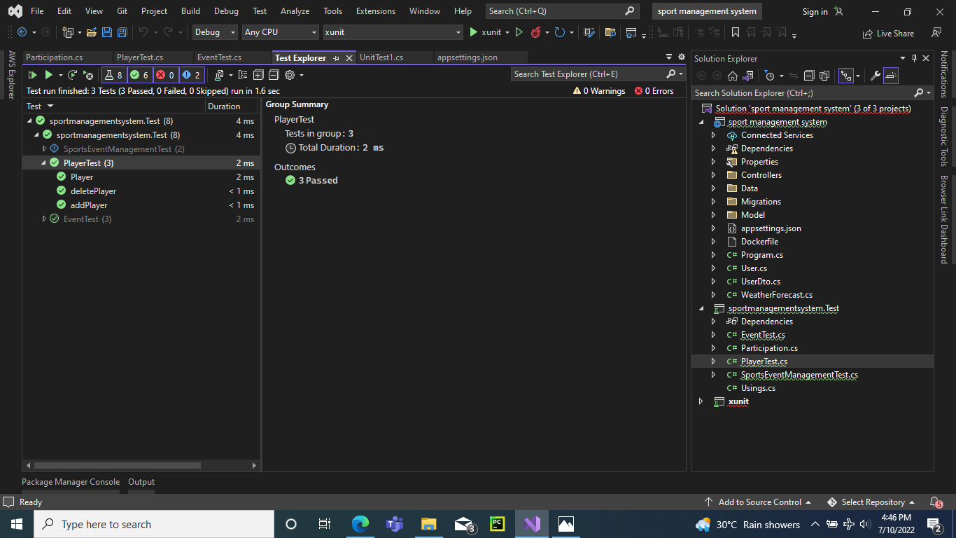
Player Microservice Testing

Slide 34
Participation Microservice

Slide 35
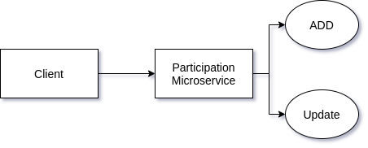
Flow Diagram

Slide 36
Entities
Participation
ParticipationId(PK) | int
PlayerId | int
playerName | nvarchar
EventId | int
EventName | nvarchar
sportsId | int
sportsName | nvarchar
Status | nvarchar

Slide 37
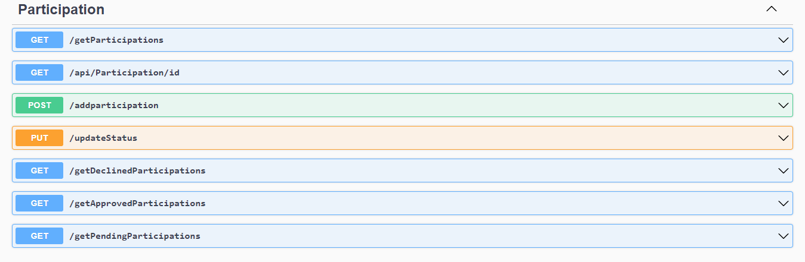
Swagger Implementation

Slide 38
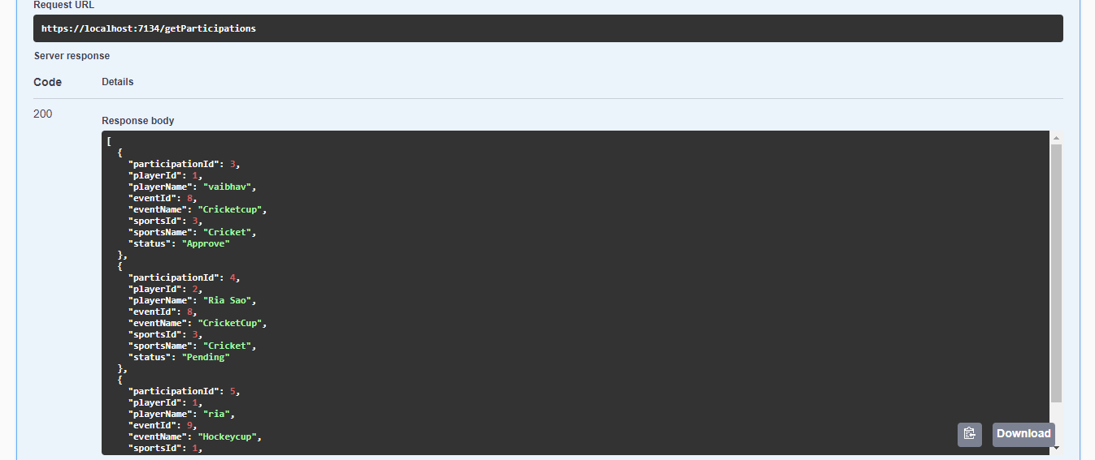
GET:/getParticipation

Slide 39
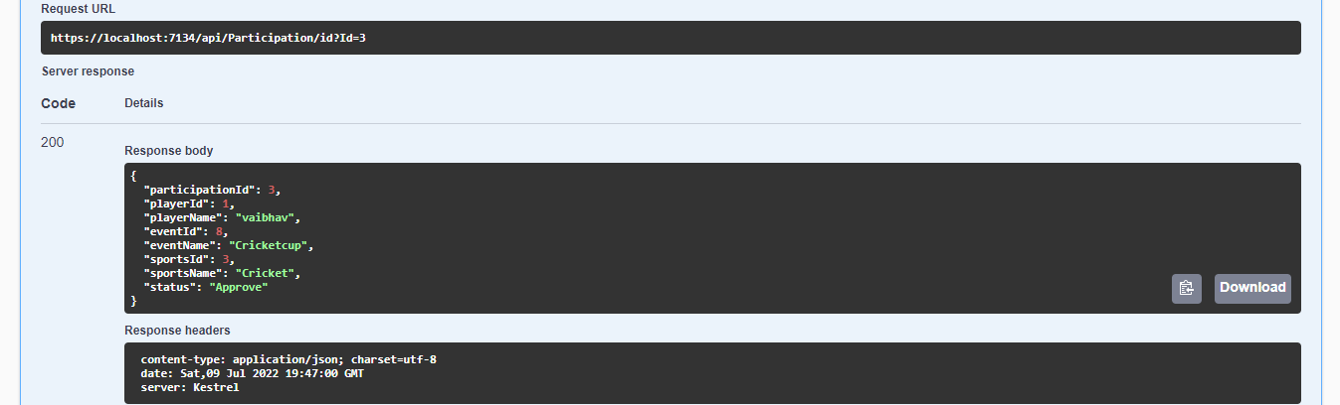
GET:/api/Participation/id

Slide 40
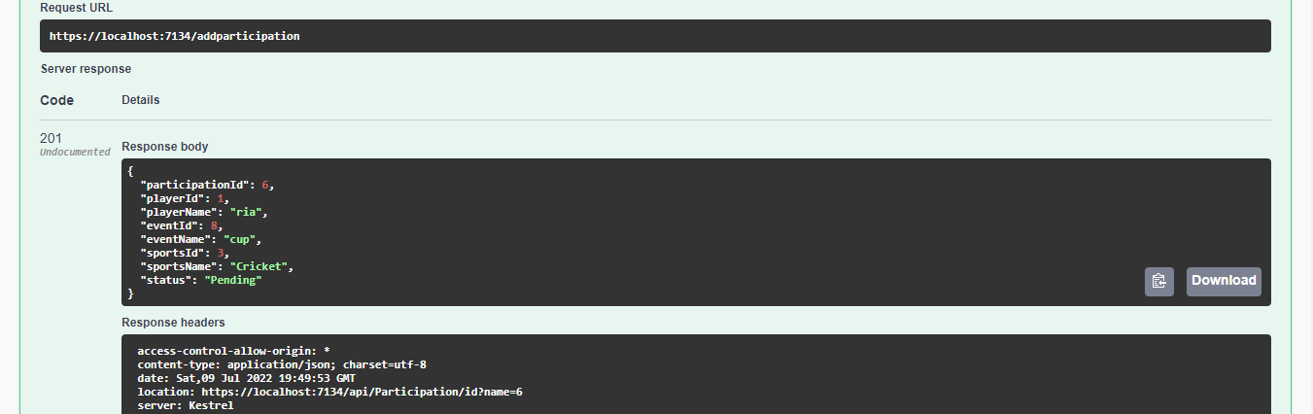
POST:/addparticipation

Slide 41
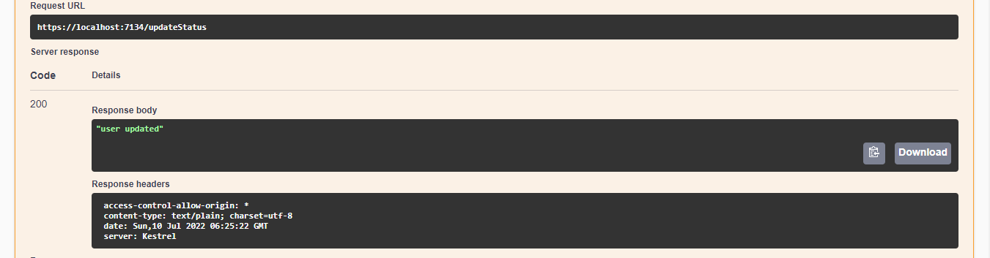
PUT:/updateStatus

Slide 42
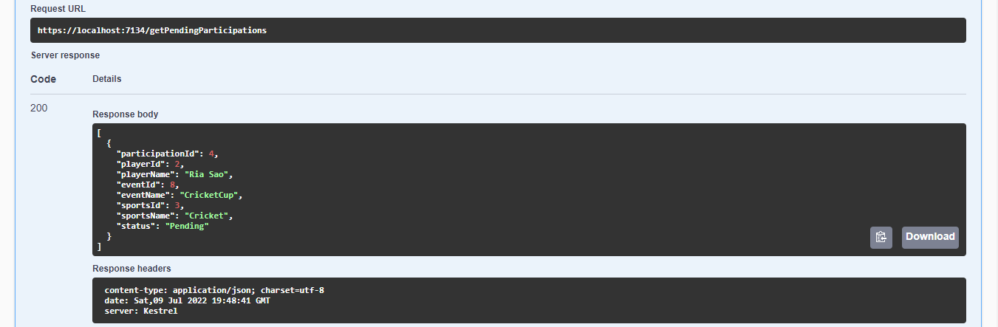
GET:/getPendingParticipations

Slide 43
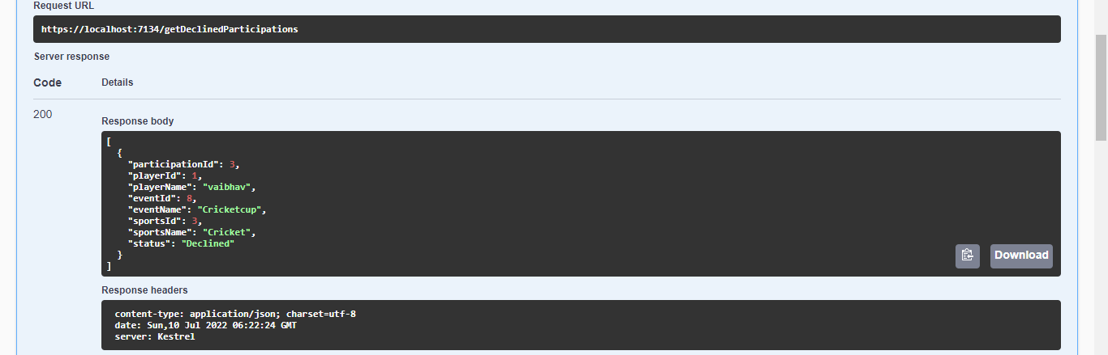
GET:/getDeclinedParticipations

Slide 44
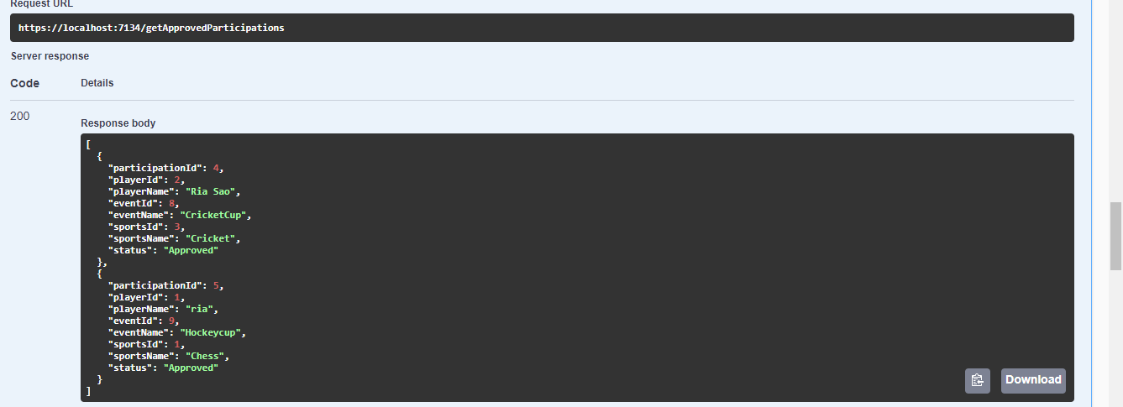
GET:/getApprovedParticipations

Slide 45
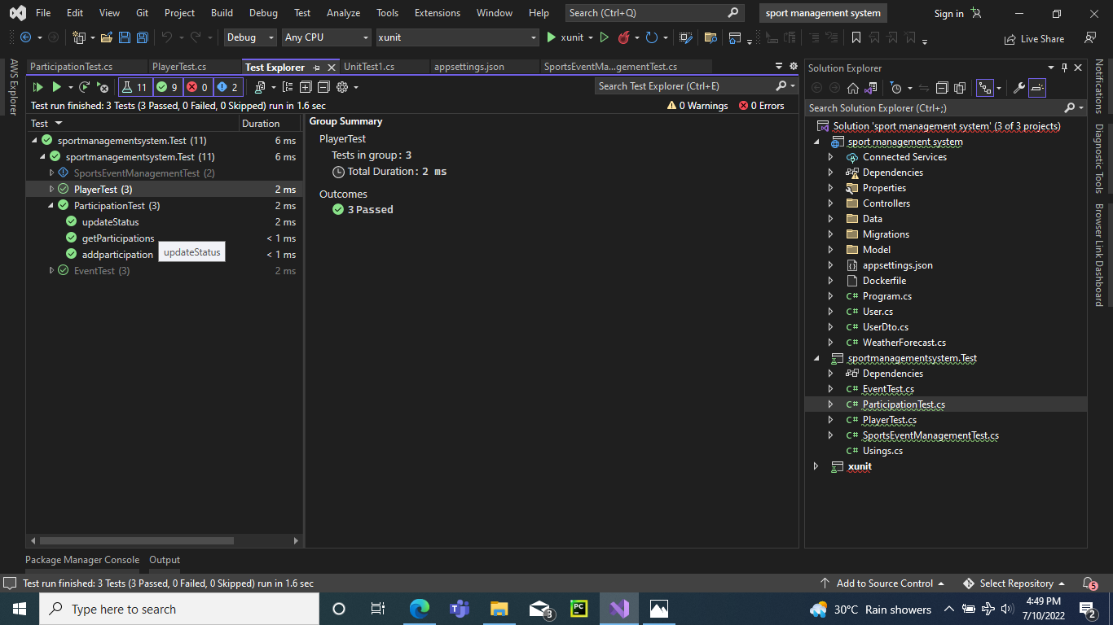
Participation Microservice Testing

Slide 46
Conclusion
This project has improved our knowledge about all concepts we learnt during training.
We learnt to work as a team, discussing every issue together to find solutions.
We also learnt how to allot time for each stages, for completing project on time.
The Sports Event Management Portal is developed for better performance to its user as a solution for large monolith system.
Every module has its respective microservices, so if one microservice got some issue then it will not affect another microservice.

